Slide 1
Combining models

Slide 2
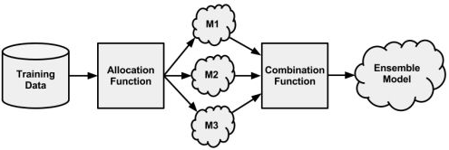
Ensemble
The meta-learning approach that utilizes a similar principle of creating a varied team of experts is known as an ensemble.
All ensemble methods are based on the idea that by combining multiple weaker learners, a stronger learner is created.

Slide 3
Allocation function dictates whether each model receives the full training dataset or merely a sample.
It could increase diversity by artificially varying the input data to train a variety of learners. For instance, it might use bootstrap sampling to construct unique training datasets or pass on a different subset of features or examples to each model.
On the other hand, if the ensemble already includes a diverse set of algorithms— such as a neural network, a decision tree, and a kNN classifier— then the allocation function might pass on the data relatively unchanged.

Slide 4
The combination function governs how disagreements among the predictions are reconciled.
For example, the ensemble might use a majority vote to determine the final prediction, or it could use a more complex strategy such as weighting each model's votes based on its prior performance.

Slide 5
Advantages of Ensembles
One of the benefits of using ensembles is that they may allow you to spend less time in pursuit of a single best model. Instead, you can train a number of reasonably strong candidates and combine them.
Better generalizability to future problems: Because the opinion of several models is incorporated, no single bias can dominate. Reduces the chance of overfitting.

Slide 6
Advantages (cntd.)
Improved performance on all kinds of datasets: Due to memory limits, it is more efficient to train several small models than a single full model. Can run various models in parallel.
Can synthesize data from different domains: Variety of data keeps increasing so multiple learners can help to capture more comprehensive picture.
Can better capture local patterns. Models that divide the task into smaller portions are more likely to capture subtle patterns.

Slide 7
Bagging (aka bootstrap aggregating)
One of the first ensemble methods
Generates a number of training datasets by bootstrap sampling the original training data.
Datasets are then used to generate a set of models using a single learning algorithm.
The models’ predictions are combined using voting (for classification) or averaging (for numeric prediction).

Slide 8
Advantages of bagging
Although bagging is a relatively simple ensemble, it can perform quite well as long as it is used with relatively unstable learners, that is, those generating models that tend to change substantially when the input data changes only slightly.
Bagging is often used with decision trees, which have the tendency to vary dramatically given minor changes in input data.

Slide 9
Boosting
Boosting is a popular ensemble-based method and it boosts the performance of weak learners to attain the performance of stronger learners.
Boosting will result in performance often quite better and certainly no worse than the best of these models. Essentially, this can improve model performance by adding more weak learners.
It is thought to be one of the most significant discoveries in machine learning.

Slide 10
Bagging vs Boosting
Similar to bagging, boosting uses ensembles of models trained on resampled data and a vote to determine the final prediction.
The key differences are that
the resampled datasets in boosting are constructed specifically to generate complementary learners,
the vote is weighted based on each model's performance rather than giving each an equal vote.

Slide 11
Adaptive boosting
Beginning from an unweighted dataset, the first classifier attempts to model the outcome.
Examples that the classifier predicted correctly will be less likely to appear in the training dataset for the following classifier, and conversely, the difficult-to-classify examples will appear more frequently.
As additional rounds of weak learners are added, they are trained on data with successively more difficult examples.
The process continues until the desired overall error rate is reached or performance no longer improves.
At that point, each classifier's vote is weighted according to its accuracy on the training data on which it was built.

Slide 12
Random forests (aka decision tree forests)
It focuses only on ensembles of decision trees.
It combines the base principles of bagging with random feature selection to add additional diversity to the decision tree models.
After the ensemble of trees (the forest) is generated, the model uses a vote to combine the trees’ predictions.
Because it uses only a small, random portion of the full feature set, it can handle extremely large datasets, where the so-called “curse of dimensionality” might cause other models to fail.
Error rates for most learning tasks are on par with nearly any other method.

Slide 13
Strengths
An all-purpose model that performs well on most problems.
Can handle noisy or missing data; categorical or continuous features.
Selects only the most important features
Can be used on data with an extremely large number of features or examples.
Weaknesses
Unlike a decision tree, the model is not easily interpretable.
May require some work to tune the model to the data.
Due to its power, versatility, and ease of use, random forests are quickly becoming one of the most popular machine learning methods.

Slide 14
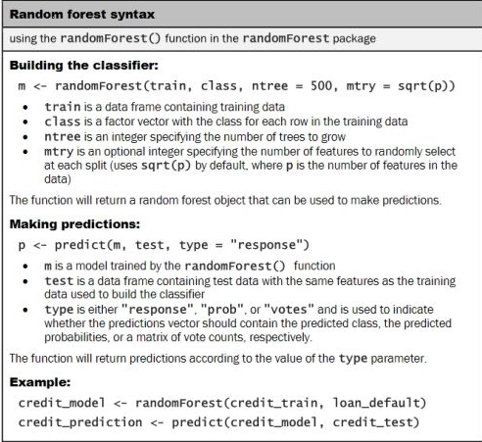

Slide 15
Random forest (cntd.)
Generally, more complex learning problems and larger datasets (both predictors/features as well as records/examples) work better with a large number of trees.
OOB (out of bag) error rate is calculated during the construction of the random forest. Records not used in training are used for validating and error-rates across different runs are averaged.

